Slide 2
01
02
03
INTRODUCTION
PARKING STRUCTURE
GROUND TRANSPORTATION CENTER
04
05
06
RTA STATION
SCHEDULE
Q&A

Slide 3
INTRODUCTION

Slide 4
PRESENTERS
DENNIS D. KRAMER, P.E., C.M.
Assistant Director, Airport Development
CITY OF CLEVELAND, DEPARTMENT OF PORT CONTROL
TERRY CASSIDY
Principal
PASLAY GROUP, EXECUTIVE PROGRAM MANAGER

Slide 5
PARKING STRUCTURE

Slide 6
PARKING STRUCTURE BASIC SCOPE PARAMETERS
Site of existing Orange Lot
6,000+ parking spaces: maximize based on allowable footprint
Maximum of 8 levels: maintain sufficient customer service levels
Parking Efficiency:
Drive aisles parallel to the longest side of garage
Parking on both sides of the drive aisle on ramps
Entrance Lanes: 6 to 8 total
Exit Lanes: 8 to 10 total
Standard Stall Widths: 9 feet
COLLABORATIVE EFFORT TO EVALUATE ALTERNATIVES

Slide 7
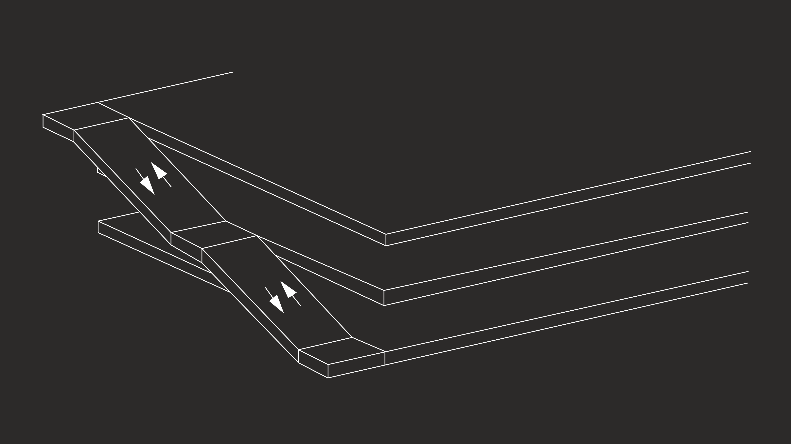
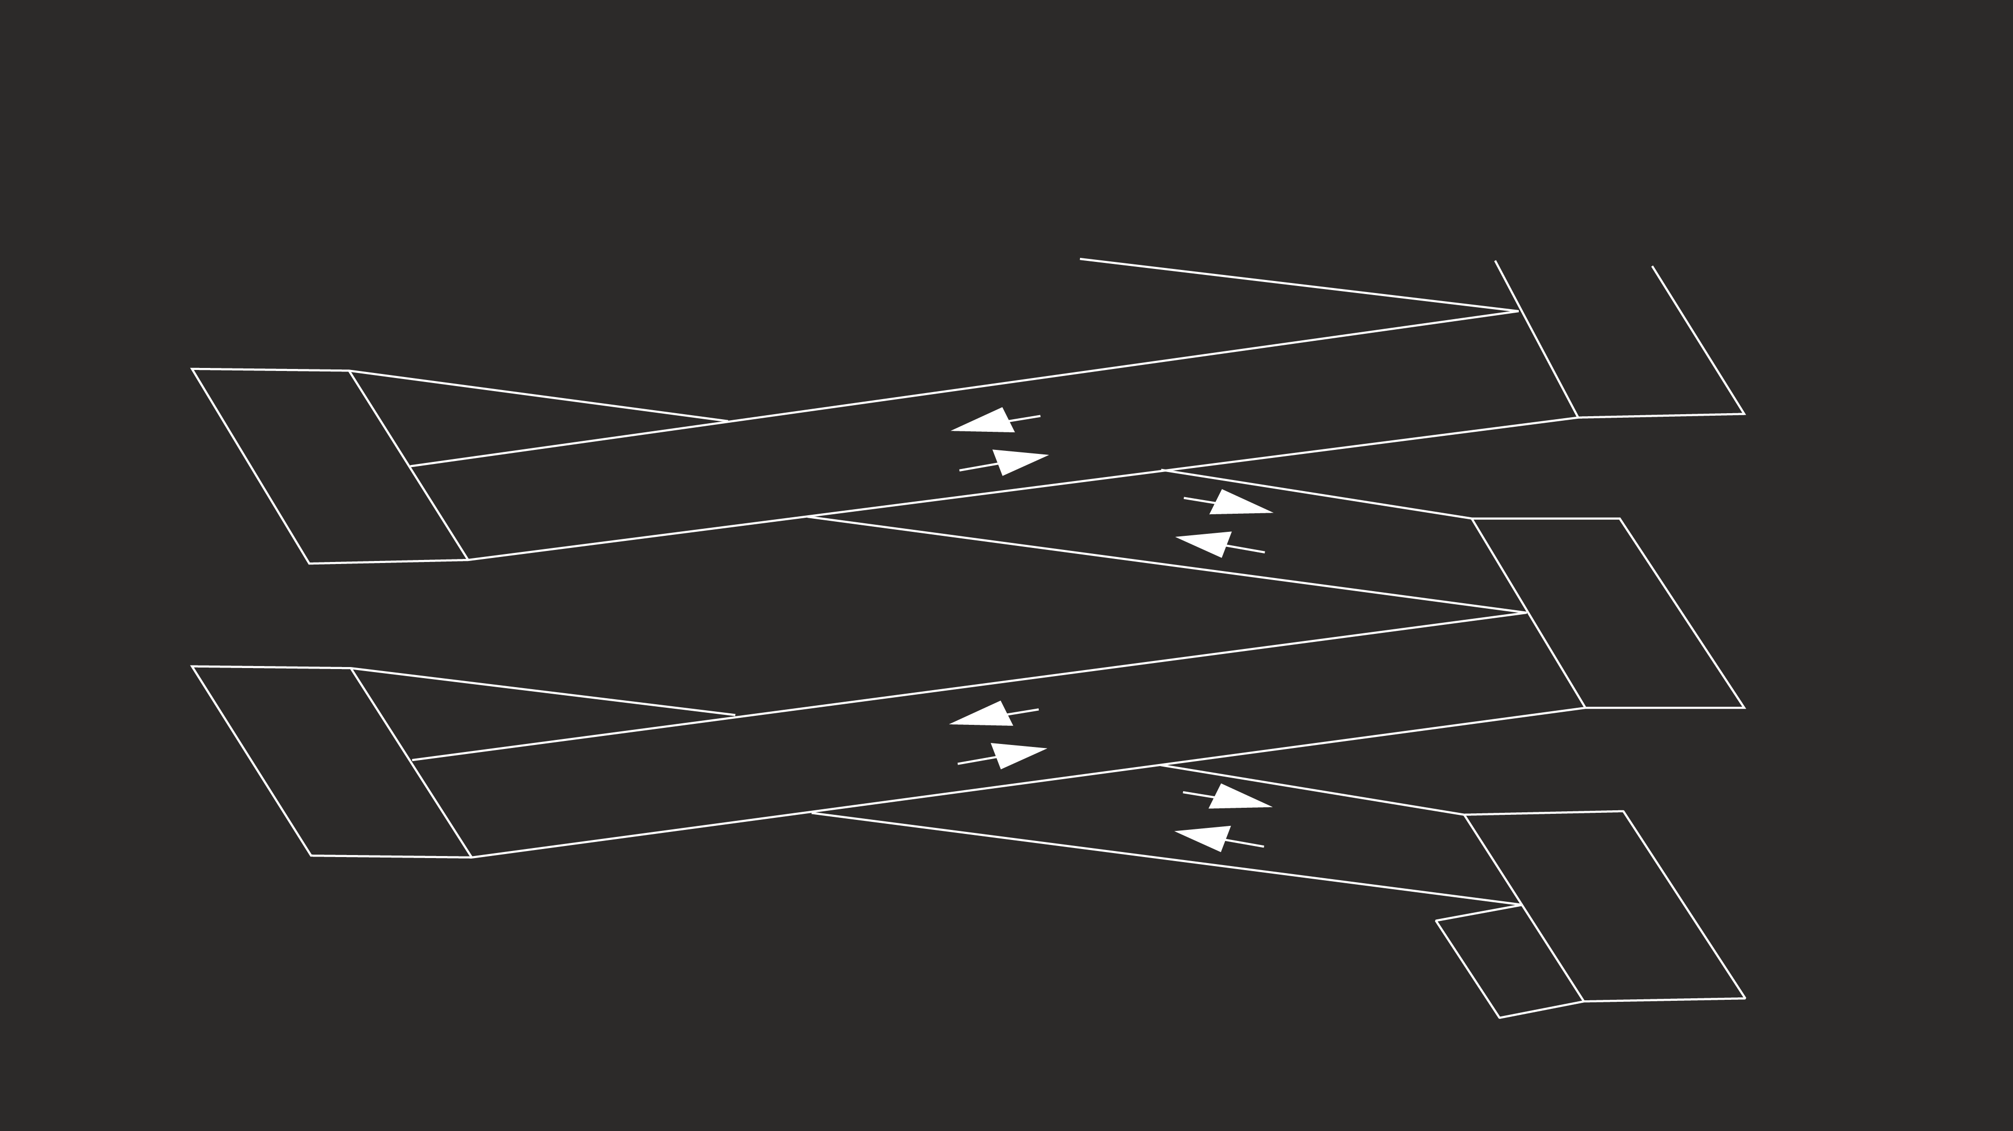
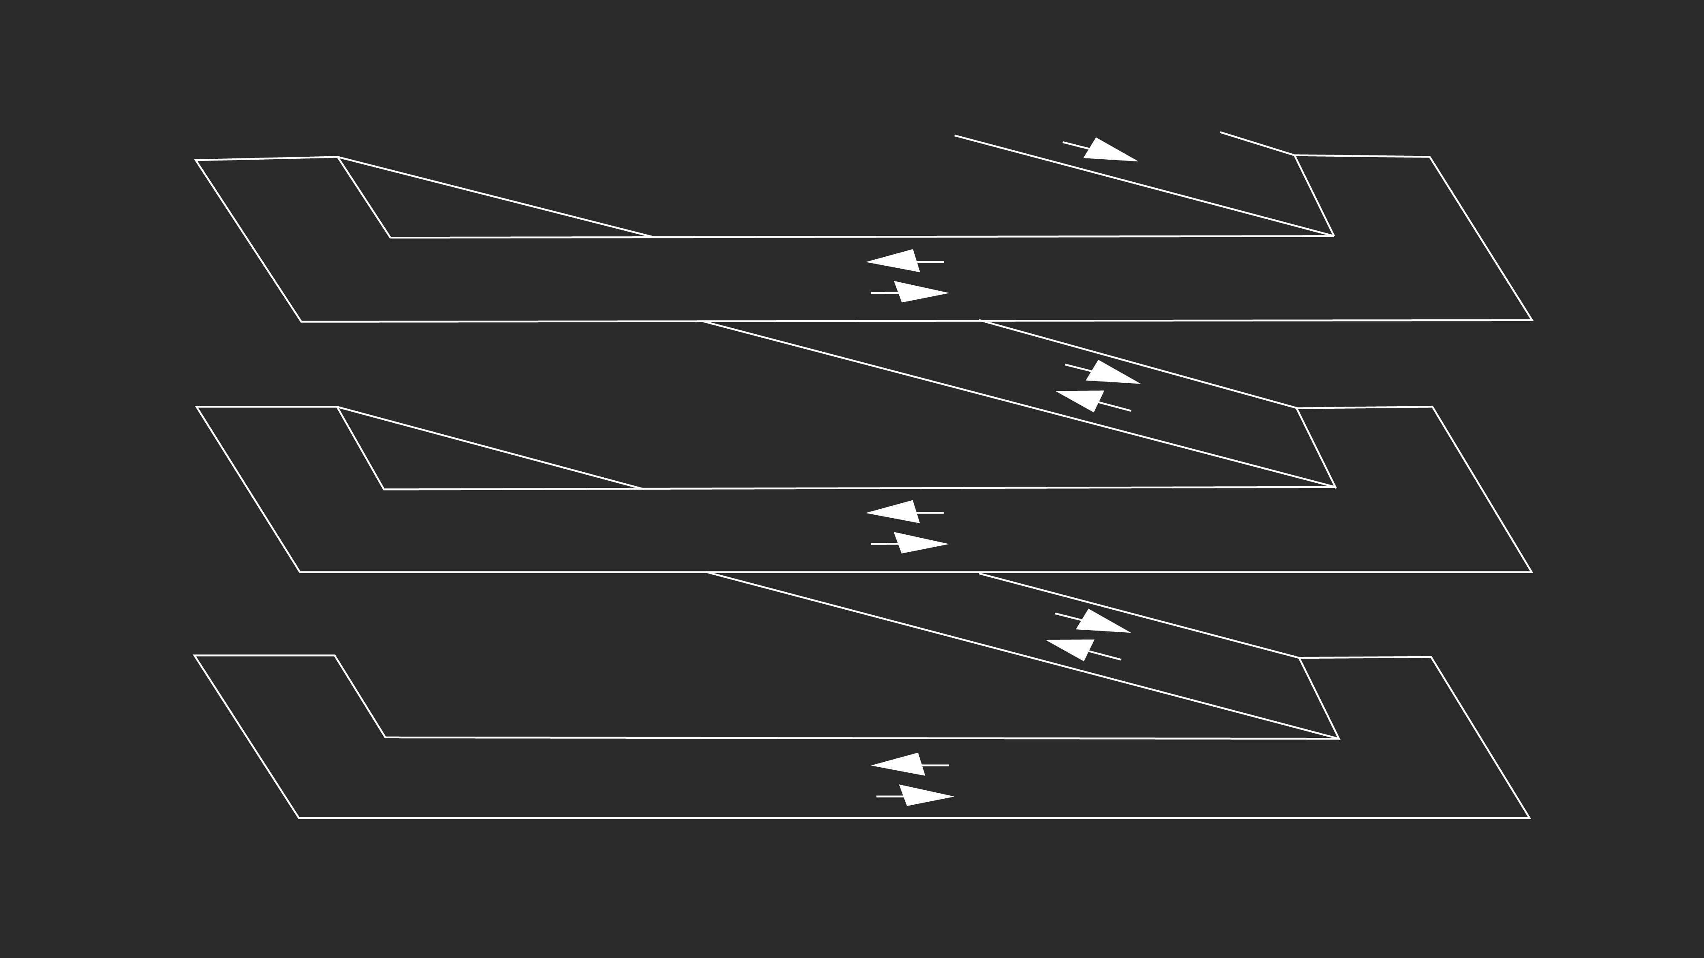
PARKING STRUCTURE Possible Ramp Options
EXTERIOR 3-LEVEL SPEED RAMPS
SINGLE THREADED HELIX WITH SLOPING FLOORS
SINGLE THREADED HELIX WITH ONE LEVEL BAY

Slide 8
PARKING STRUCTURE
OTHER CONSIDERATIONS
Construct over new RTA tunnel & station
Vertical circulation to connect new RTA tunnel & station
New connection to existing rail tunnel for pedestrian traffic
Future connection to pedestrian bridge
Future connection to phase 2 parking structure
Sustainability features
Procore Project Management System
COLLABORATIVE EFFORT TO EVALUATE ALTERNATIVES

Slide 9
GROUND TRANSPORTATION CENTER

Slide 10
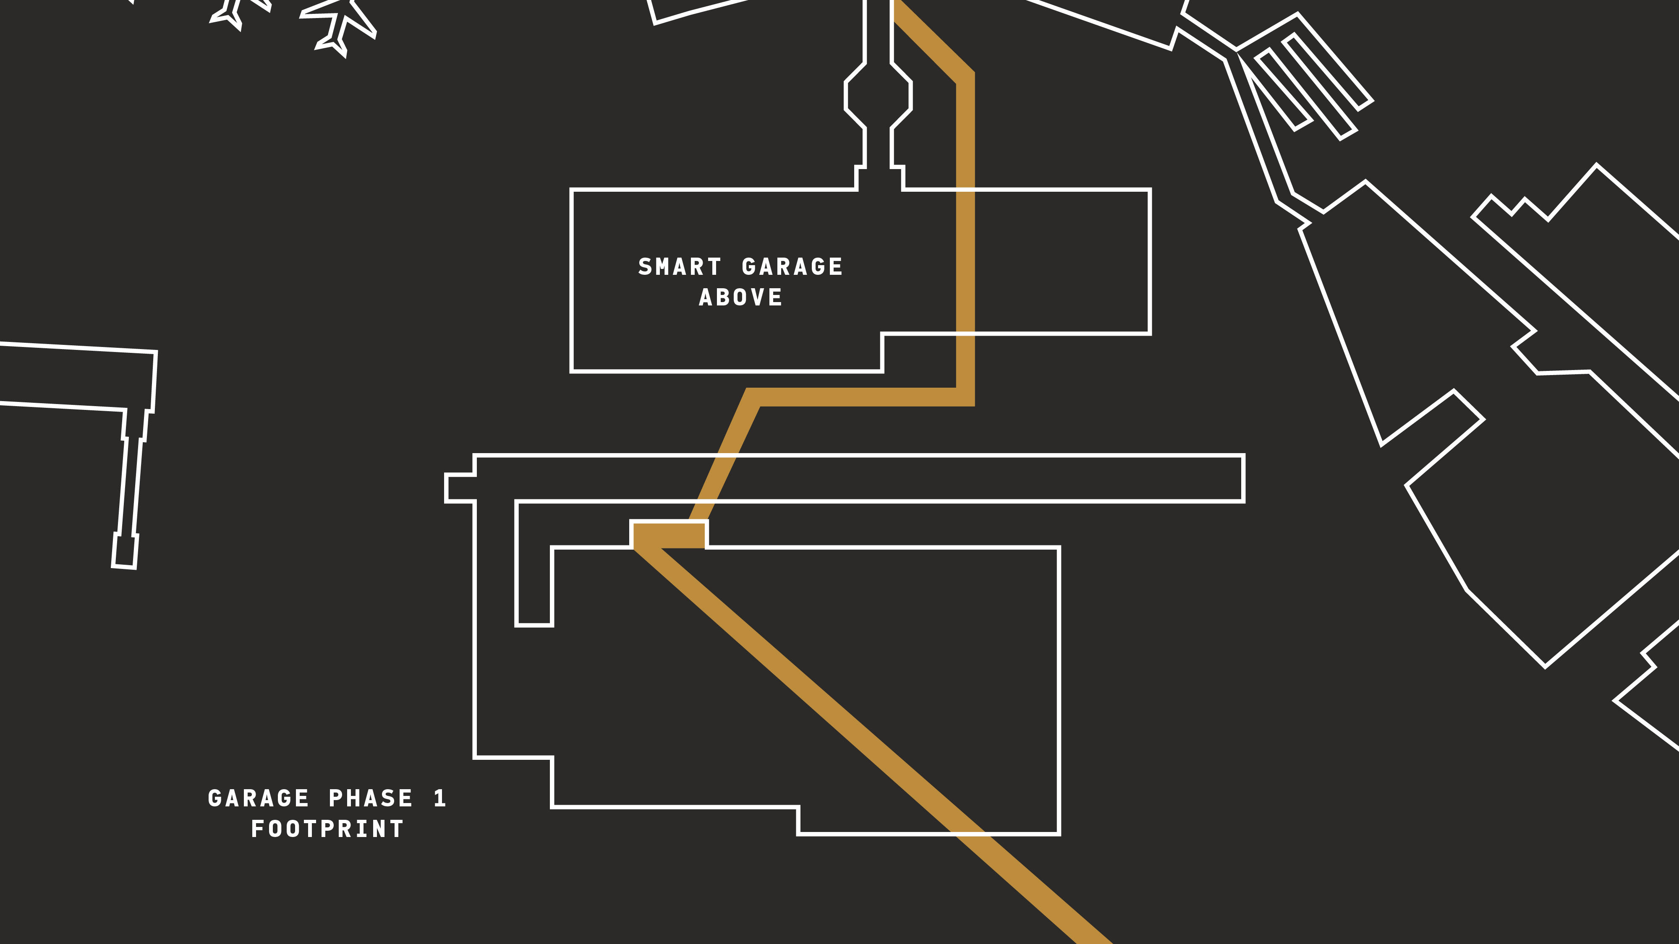
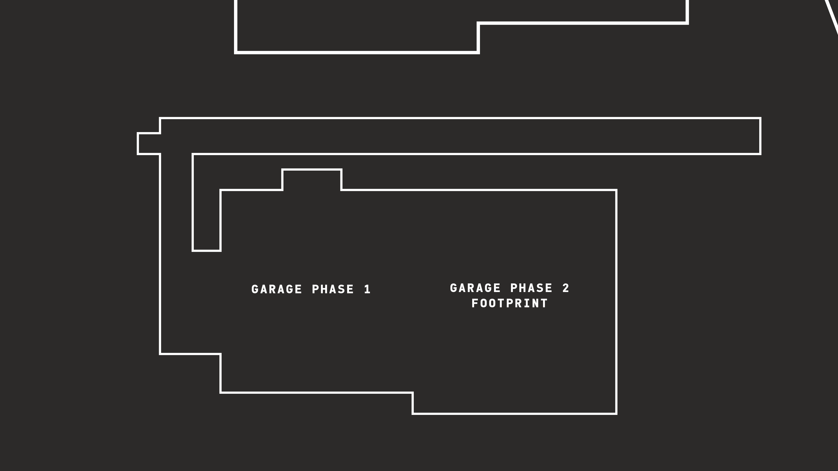
PARKING STRUCTURE & GROUND TRANSPORTATION CENTER & RTA STATION
DESIGN & BUILD PROFESSIONAL SERVICES

Slide 11
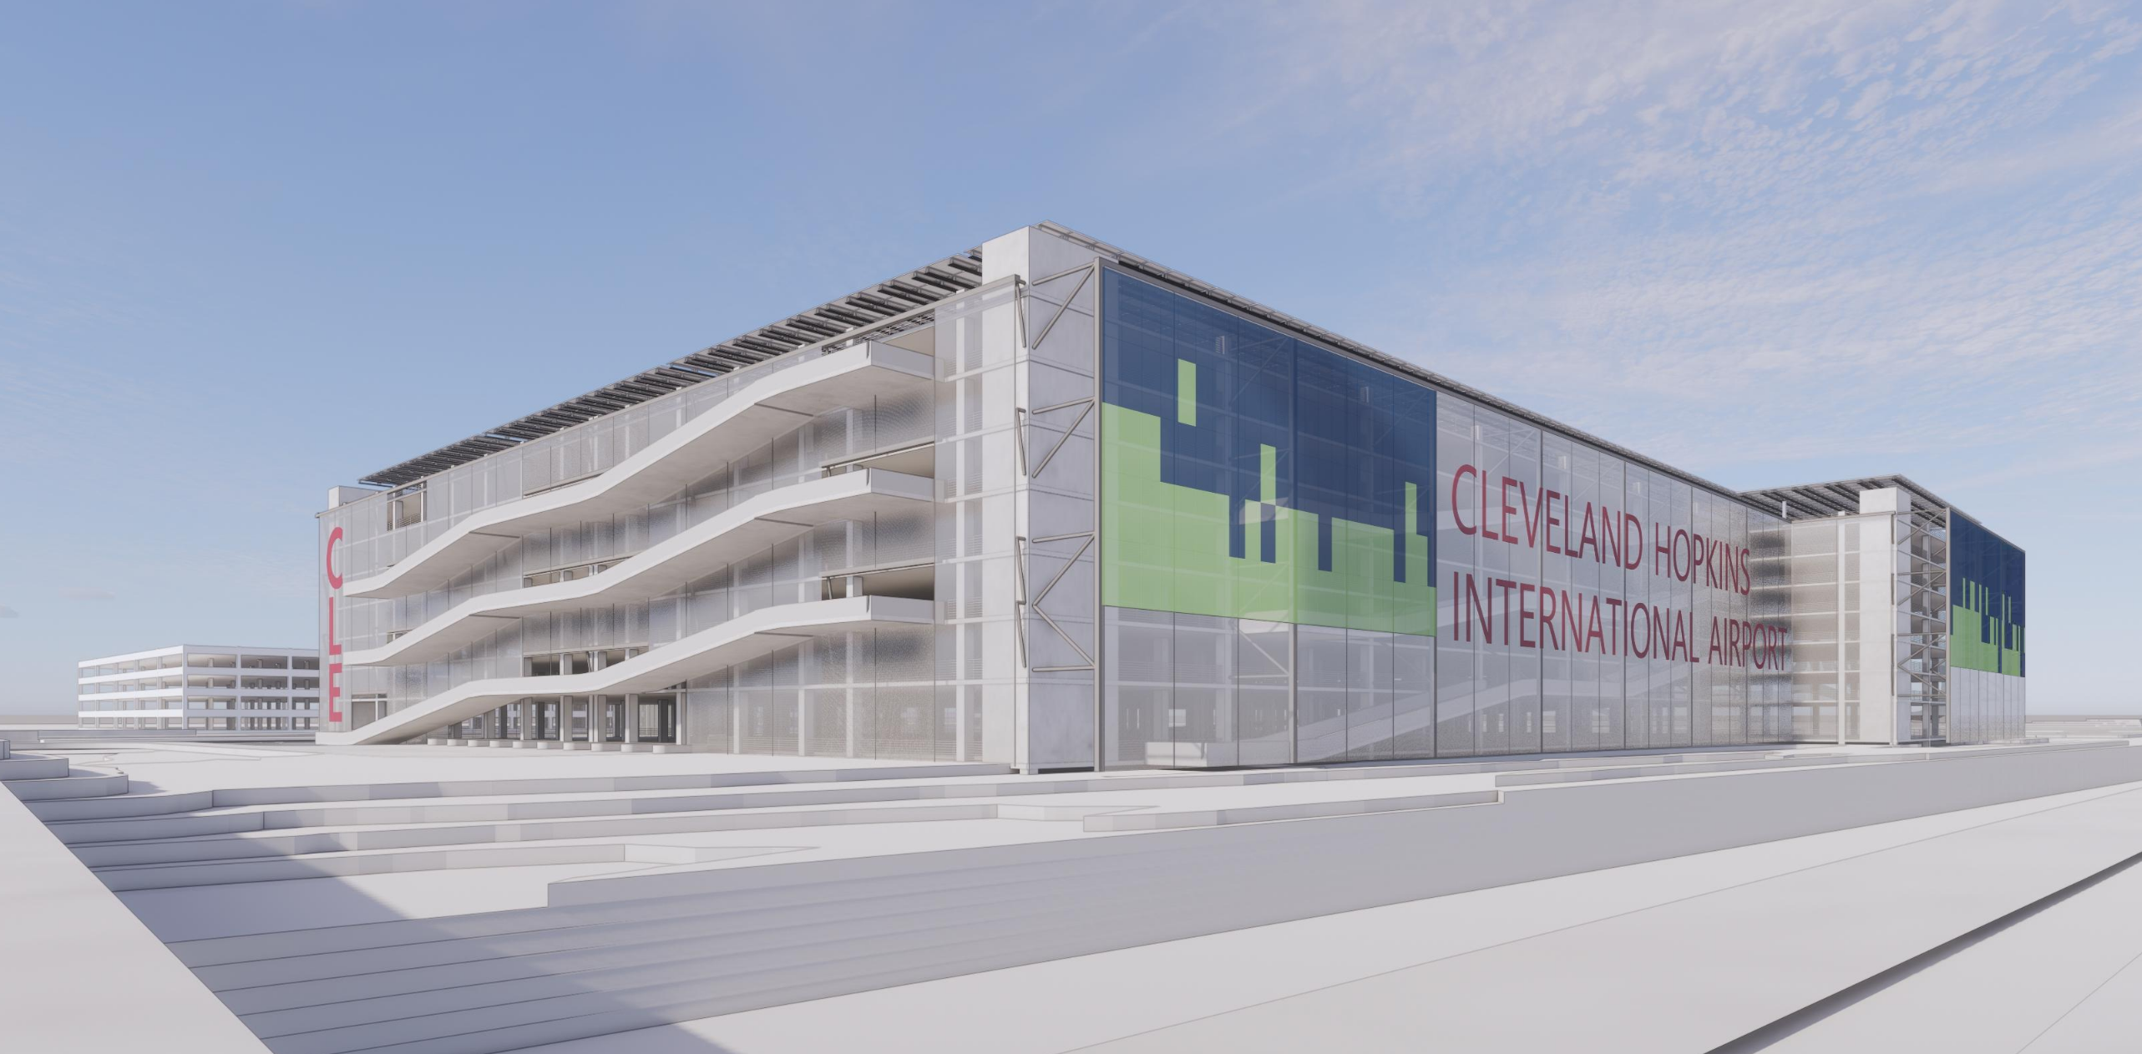
PARKING STRUCTURE & GROUND TRANSPORTATION CENTER & RTA STATION
DESIGN & BUILD PROFESSIONAL SERVICES

Slide 12
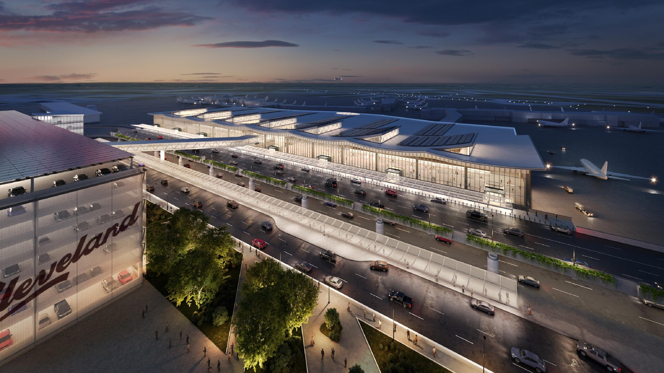

Slide 13
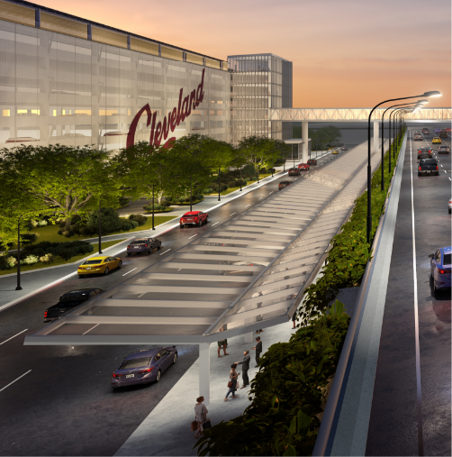
GROUND TRANSPORTATION CENTER
BASIC SCOPE PARAMETERS
Central location for all ground transportation service providers
Shuttles
Rideshare
Taxis
Limos
Other
COLLABORATIVE EFFORT TO EVALUATE ALTERNATIVES

Slide 14
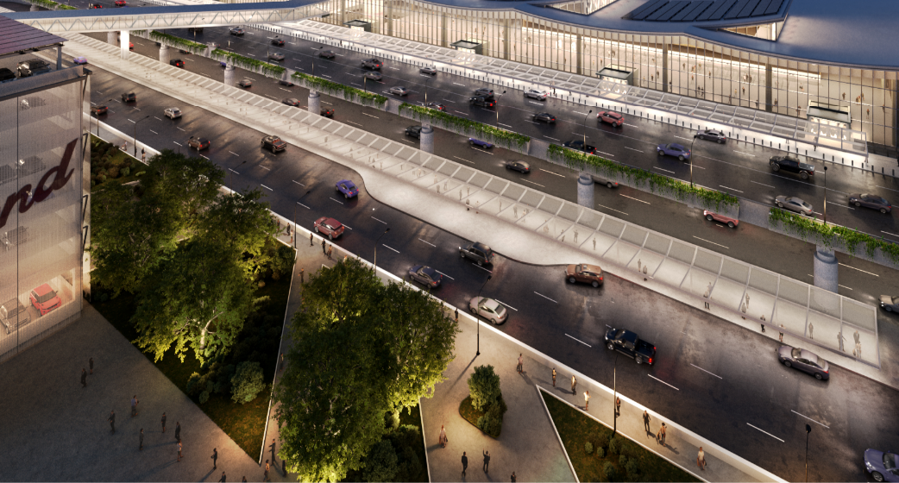
GROUND TRANSPORTATION CENTER
OTHER CONSIDERATIONS
Weather protection from the elements
Intuitive wayfinding and passenger experience elements
Passenger safety: separation of passenger traffic and vehicular traffic
Sustainability features
COLLABORATIVE EFFORT TO EVALUATE ALTERNATIVES

Slide 15
RTA STATION

Slide 16
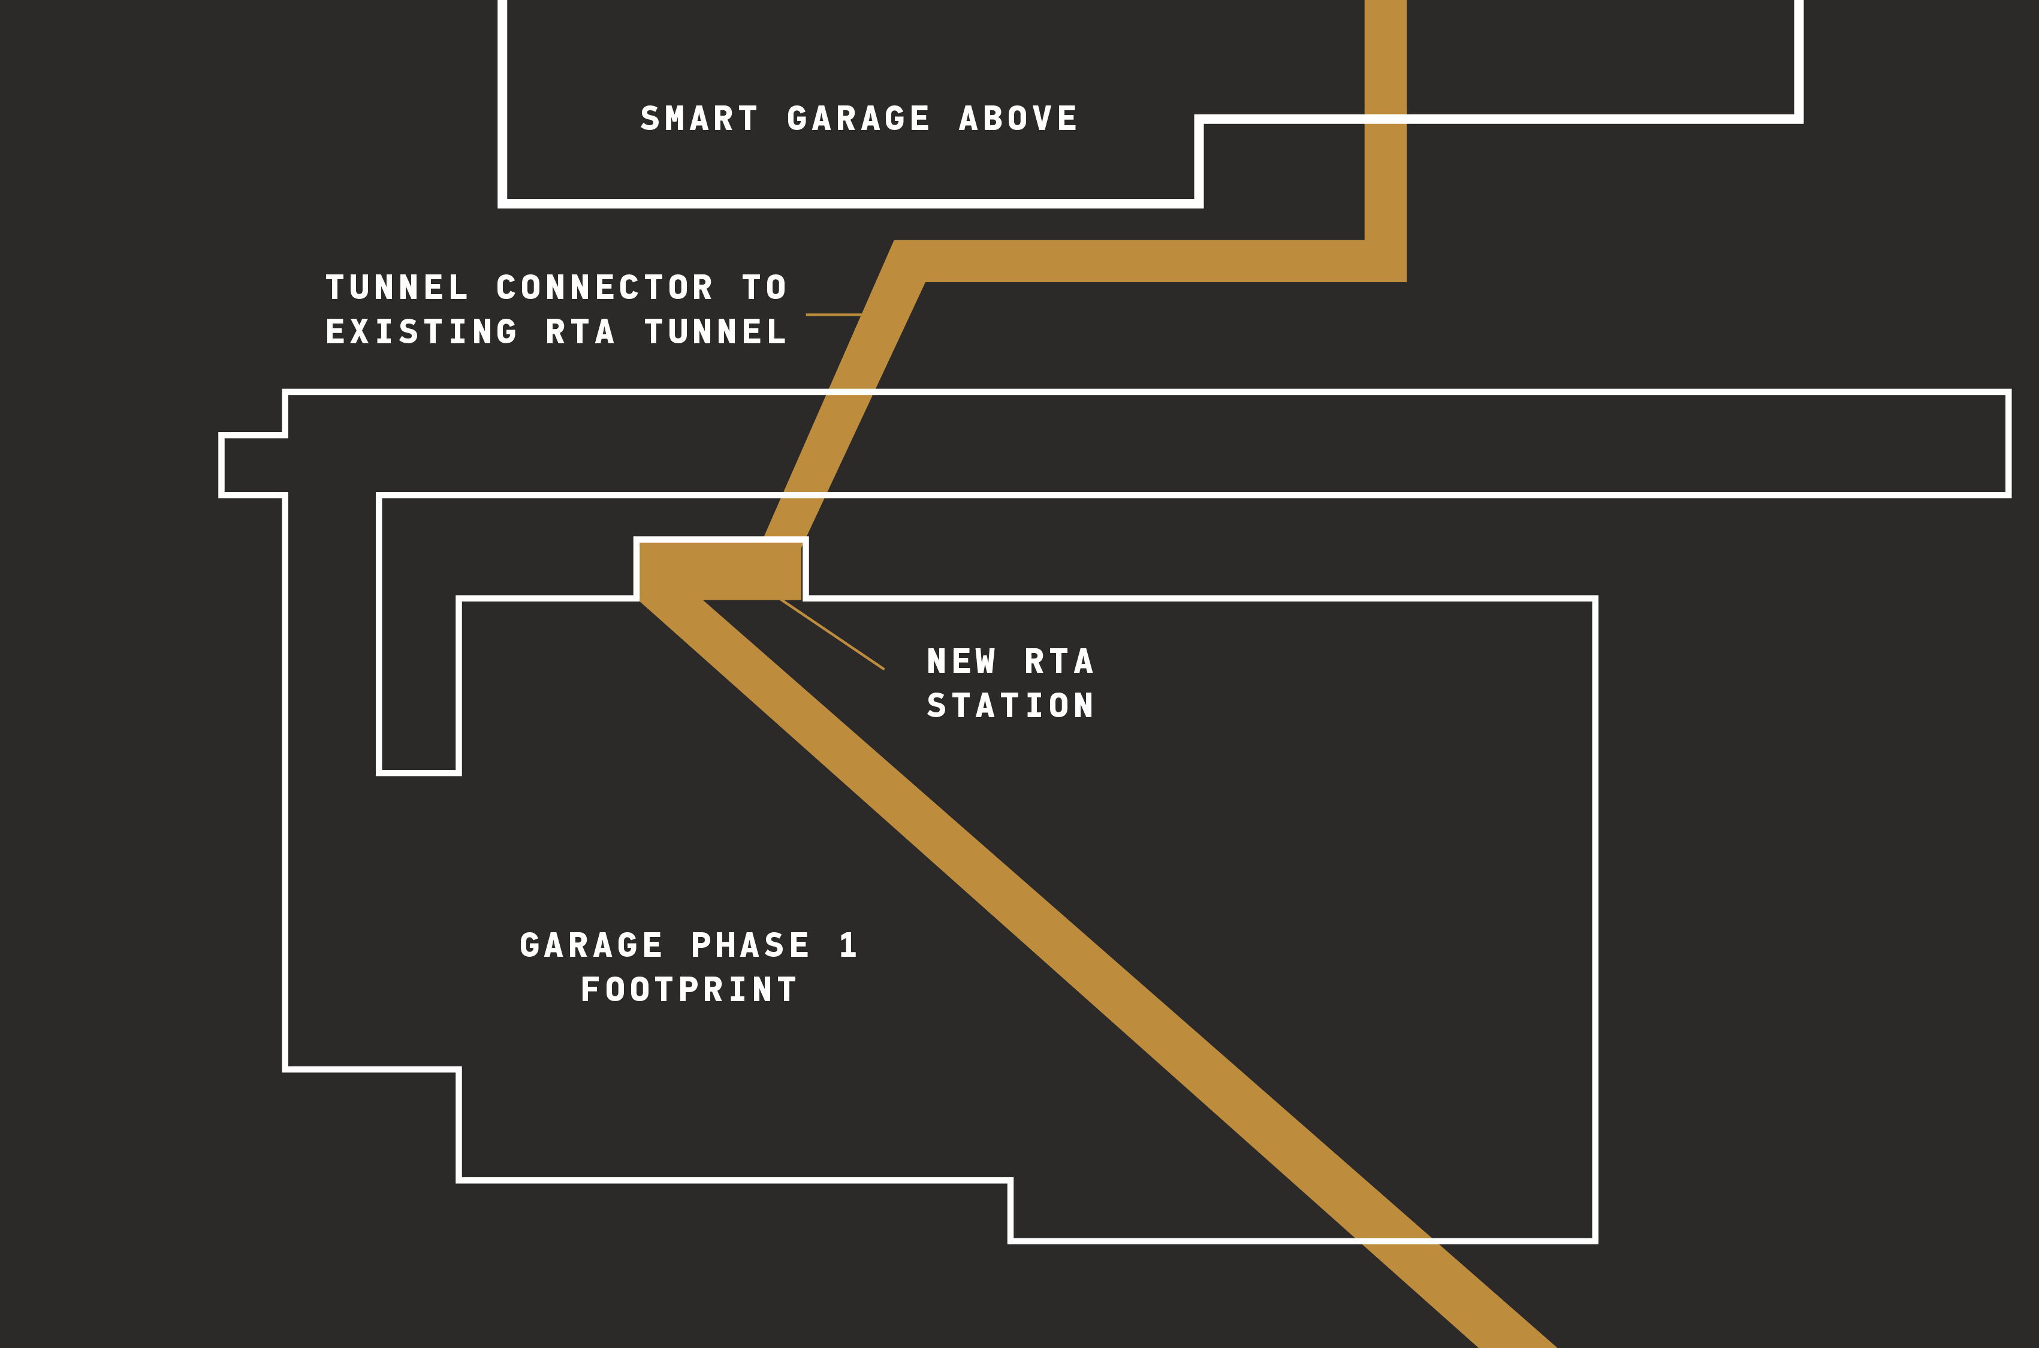
RTA STATION
BASIC SCOPE PARAMETERS
RTA Red Line Service
New tunnel with new alignment
New station in new location
Standard RTA design parameters
Tunnel
Tracks & switching
Station platform
COLLABORATIVE EFFORT TO EVALUATE ALTERNATIVES

Slide 17
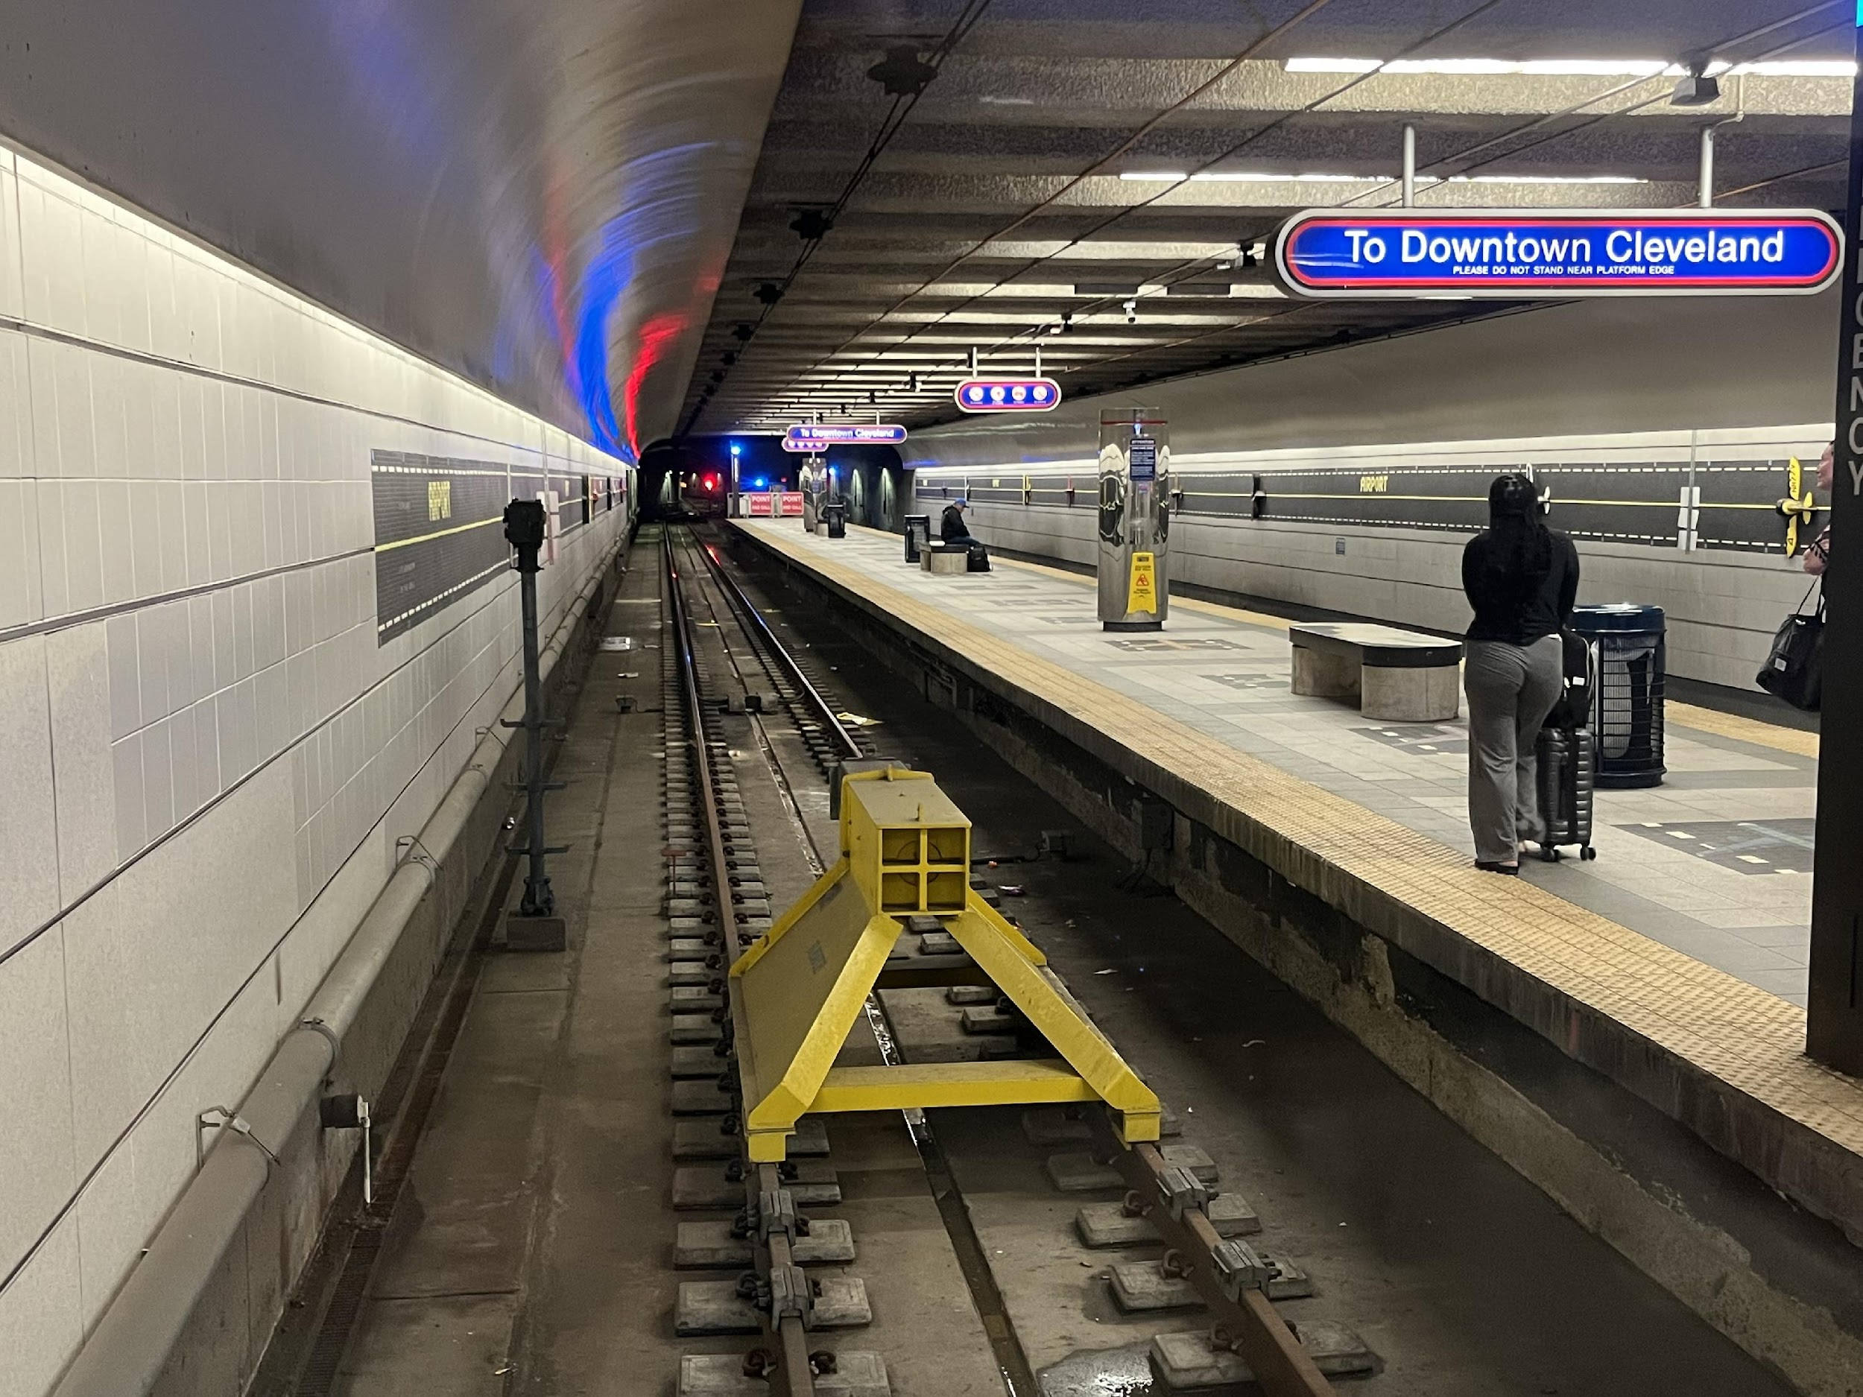
RTA STATION
OTHER CONSIDERATIONS
New parking structure above
New RTA rail cars
Sustainability features
COLLABORATIVE EFFORT TO EVALUATE ALTERNATIVES

Slide 18
SCHEDULE

Slide 19
PARKING STRUCTURE & GROUND TRANSPORTATION CENTER & RTA STATION
DESIGN & BUILD PROFESSIONAL SERVICES
SCHEDULE
PROCUREMENT
DESIGN & CONSTRUCTION
07-01-2025 to 10-13-2025
10-14-2025 to 02-28-2029 (D/B Proposed Schedules May Finish Sooner)

Slide 20
Q & A

Slide 21
THANK YOU FOR YOUR SUPPORT IN OUR PROGRAM
For more information, please visit itsaclevolution.com

Slide 22
The renderings, illustrations, and visual materials presented herein are intended for conceptual and illustrative purposes only. They do not represent the final design, specifications, or materials and are subject to change without notice. Final outcomes may vary based on design development, regulatory approvals, and other considerations.
This presentation is confidential and intended solely for internal review. It is not for public distribution or external sharing without prior written consent.

